Slide 1


ARCs are the basis of the collaborative research platform
ARCs can be seamlessly shared between researchers

Slide 2

ARCs are “understandable”
find it
place it
find it
FAIRness for everybody

Slide 3
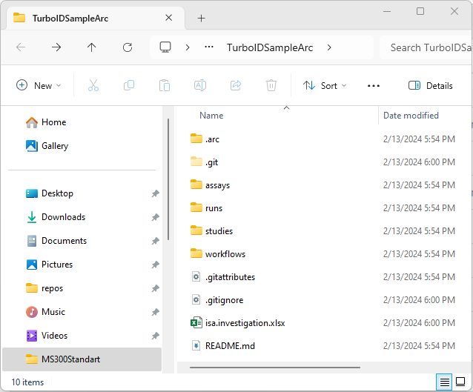
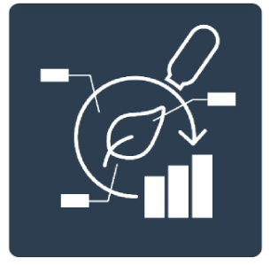
ARCs: Share yours and work together
ARCs are the basis of the collaborative research platform
ARCs can be seamlessly shared between researchers

Slide 4


ARCs track changes and are in backup
versions
restore it

Slide 5

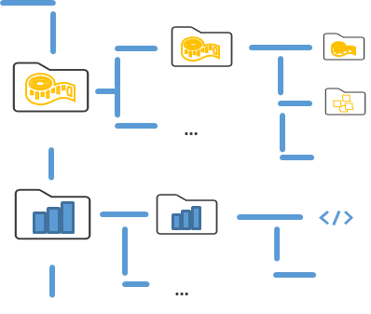



Using the PLANTDataHUB to collaborate
PLANTdataHUB instance
ARC
Issues
…
…
CWL
ARC
Issues
….
….
….
Notes:
So whats this DataHUB in a nutshell?
The datahub is a cloud-based solution that researchers like researcher A can upload their ARCs to.
Besides this functionality, the Datahub also offers the possibility issues that can be used to discuss your project and communicate
By default every ARC is private that means only other users that are invited to you ARC can visit and see your ARC. So in order for this to happen Researcher A has to invite Researcher B and C, the privacy of your data is thus maintained.
So how does an ARC look like on the DataHUB and how to use it?

Slide 6
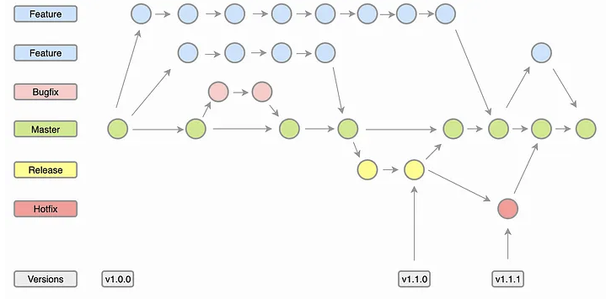
Collaboration Workflows
Add Assay
PhD student
Add Assay
Change Analysis
data scientist
Main
data steward
Update Metadata
Correct Error
external collaborator
Domain specific conventions are easy to implement

Slide 7
Collaboration Workflows
Large degree of flexibility
social convention vs. technological limitation
lab-specific / institution-specific workflows possible (necessary)
Domain specific conventions are easy to implement
Processes and roles well understood in (open source) software engineering

Slide 8
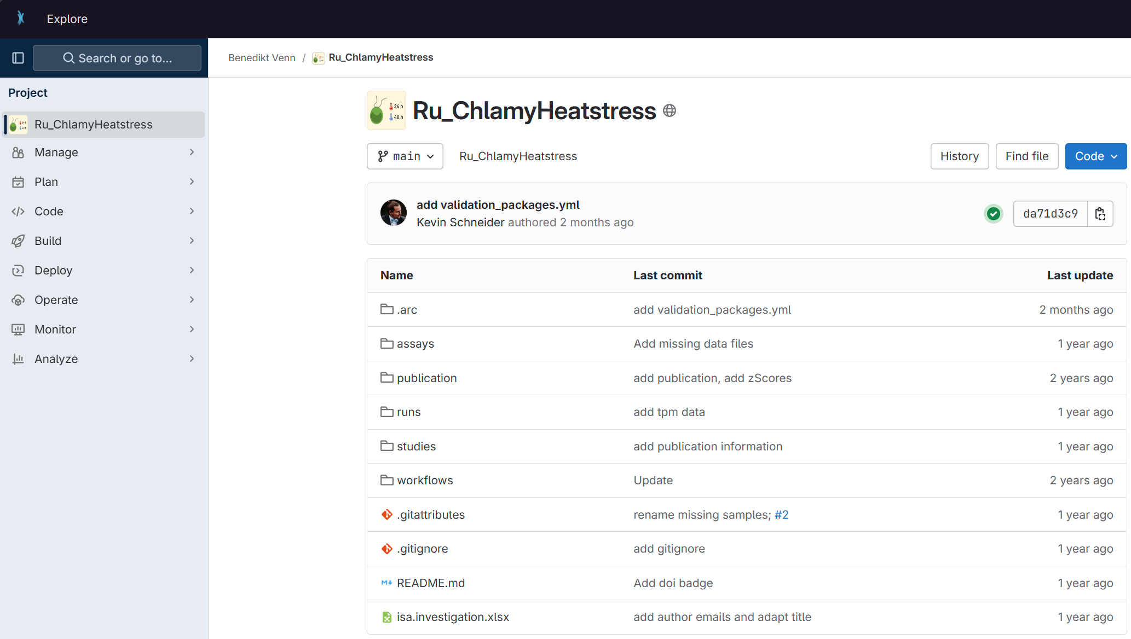
PLANTDataHUB live
Browsing the ARC on the PLANTDataHUB platform
Notes:
Show the number of commits and commit history

Slide 9
Notify your colleagues
PLANTdataHUB instance
ARC
Issues
…
…
CWL
ARC
Issues
….
….
….
Notes:
But we can we also directly discuss project specific issues online using the datahub online.

Slide 10
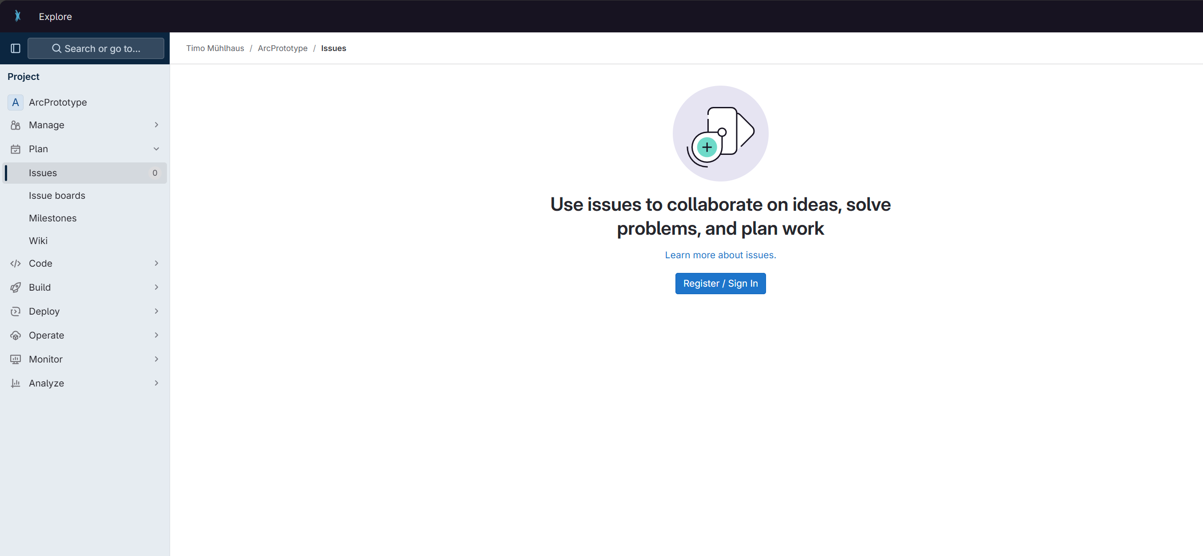
PLANTDataHUB live

Slide 11

FAIR data publication
annotation
reference
research data
journal publication
reference
journal publication
“Digital change starts with a change in mind set of all researchers”

Slide 12


Automatization: “Build, deploy, and validate”
…
build
A
B
C
D
+
ARC Scaffold
check-in
deploy
validate
ARC-RO-Crate
[JSON-LD]
result
Continuous integration for seamless interoperation

Slide 13
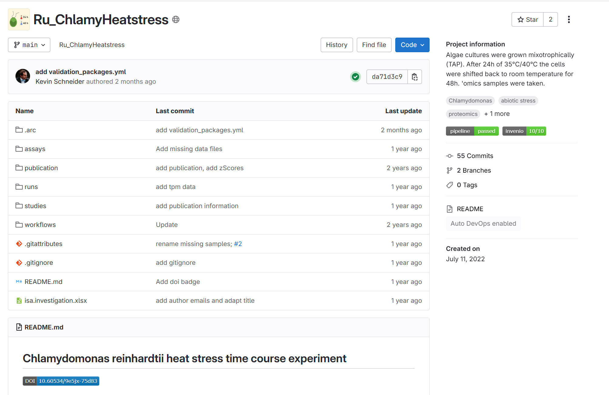
Validation towards INVENIO

Slide 14


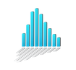
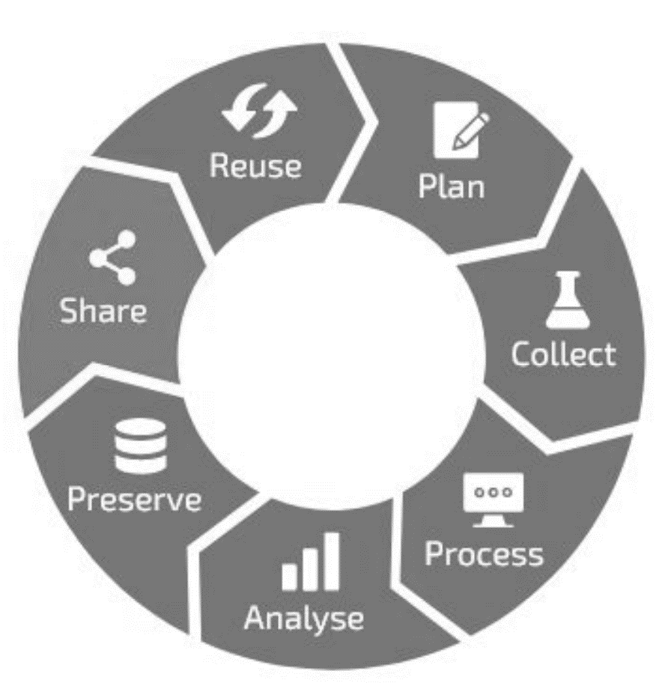


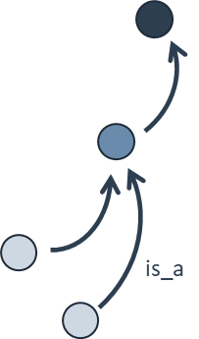





Participate in a thriving RDM ecosystem
EBI: MetaboLights
controlled vocabulary
specialized endpoints
dataset search
A
B
C
D
data publication
ARC enables researchers to participate in a thriving RDM ecosystem without barriers
Zenodo 2023 https://doi.org/10.5281/zenodo.10091038

Slide 15
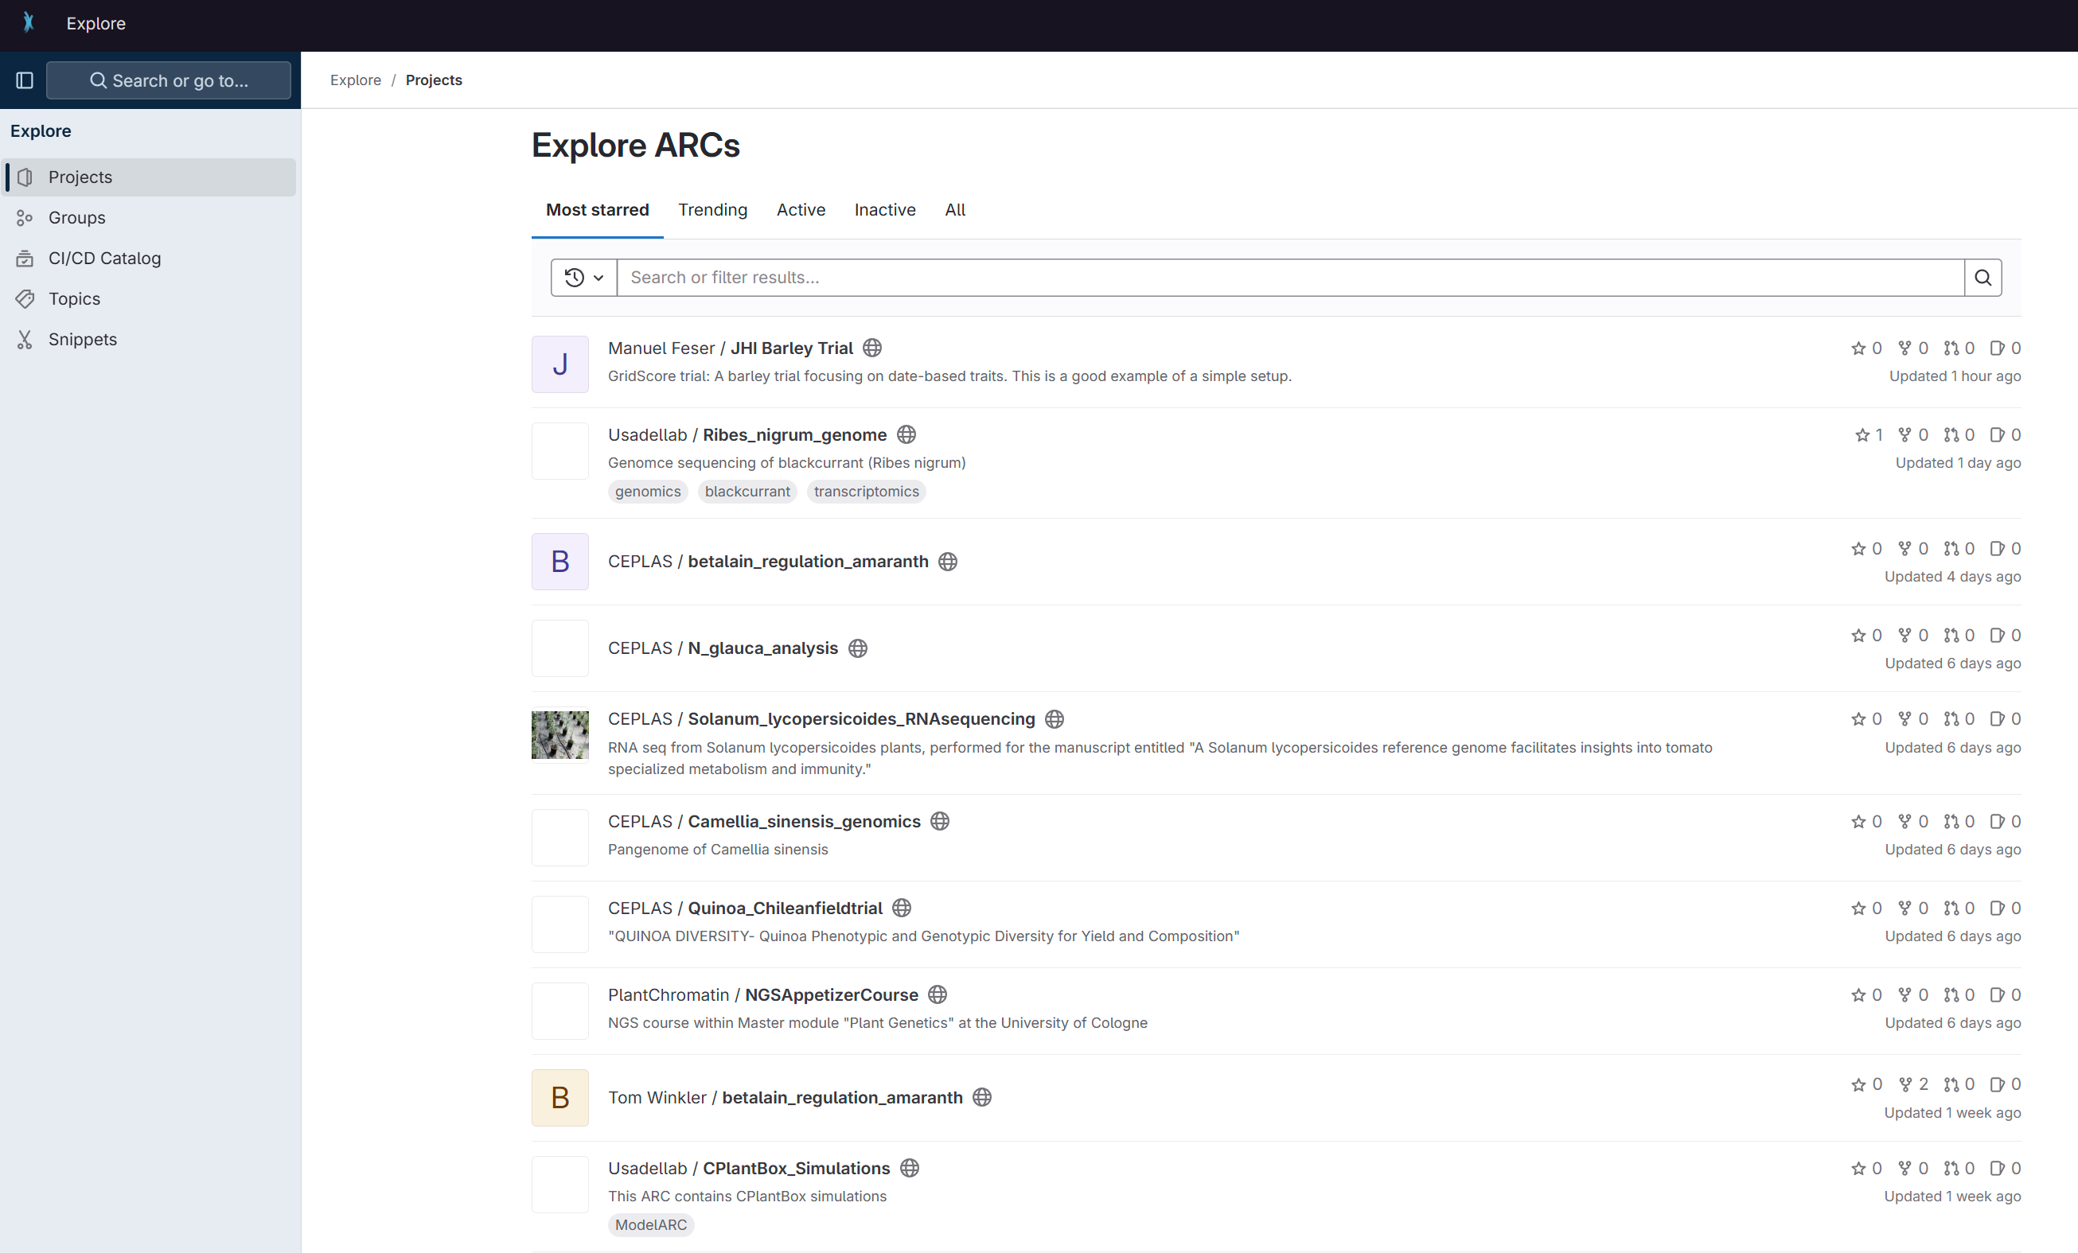
PLANTDataHUB live

Slide 16
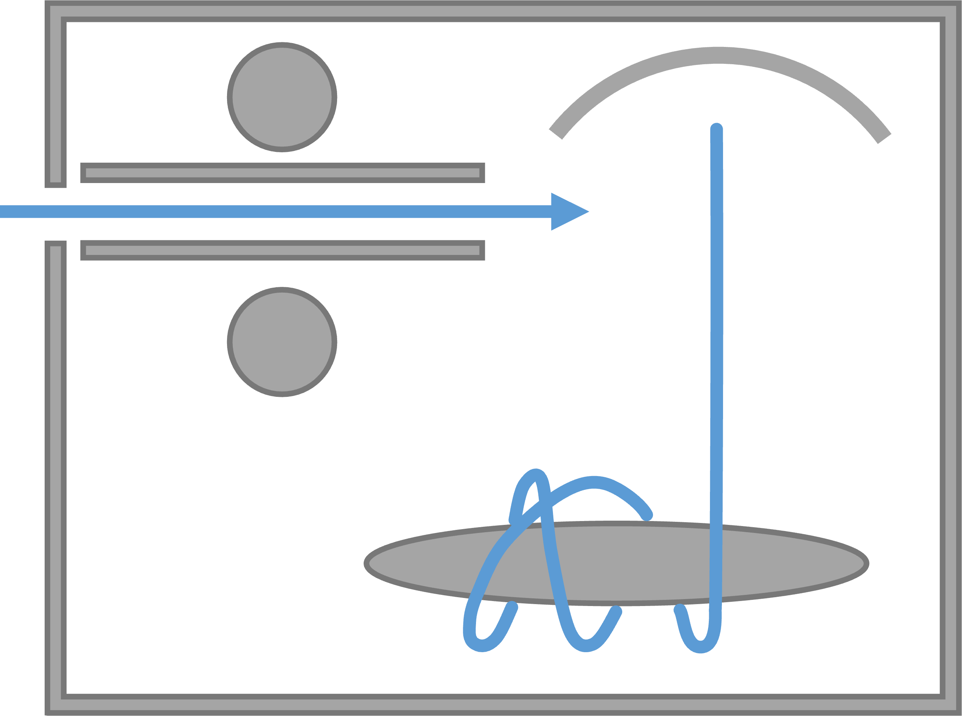
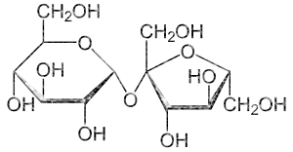
Create the second assay

Slide 17
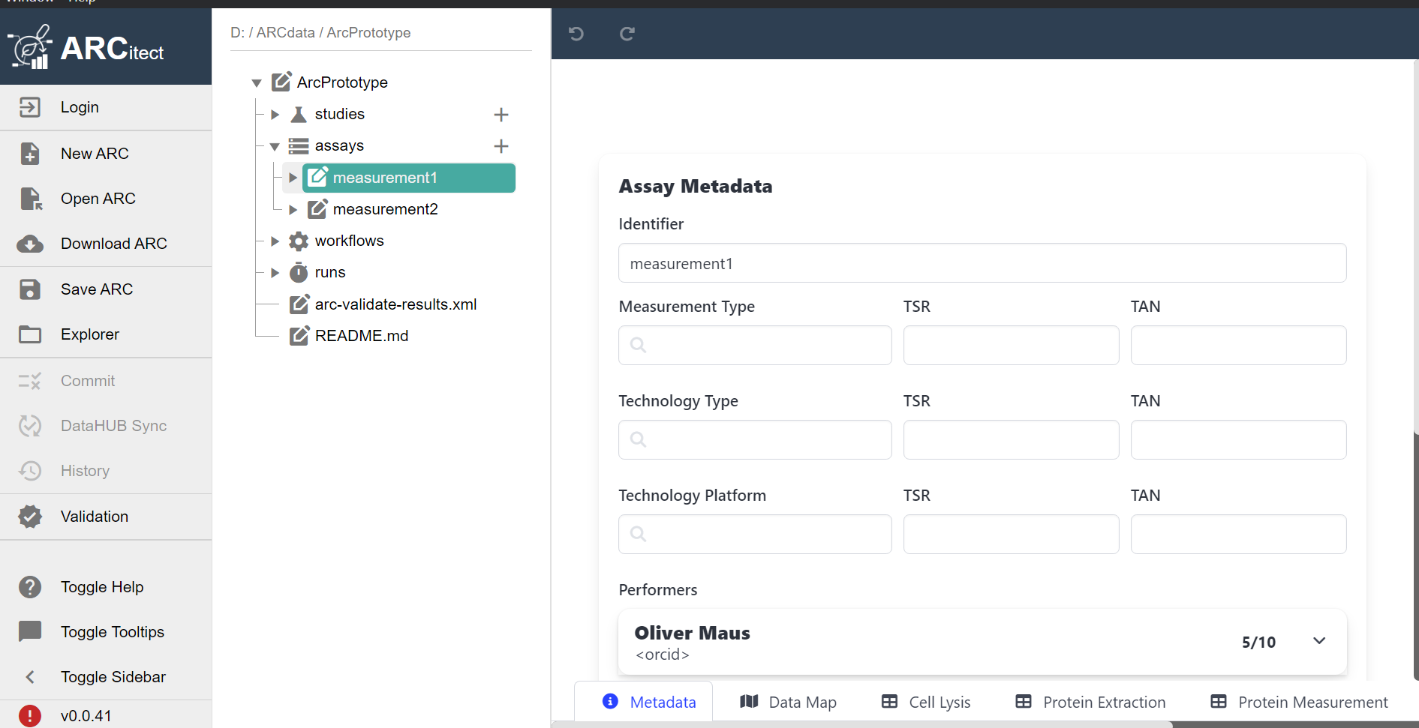
Creating a new assay
Term Source Reference
Identifier
Measurement Type
Technology Type
Technology platform
Performer
Term Accession Number

Slide 18
Save time using standard methods and SOPs
MS/MS
Parameter []
Protein Precipitation
acetone
cleavage agent name
Trypsin
sample preparation
reversed-phase solid-phase extraction
…
…
intensity
m/z
full MS
intensity
m/z
MS Measurement

Slide 19
Save time using standard methods and SOPs
Component []
chromatography instrument model
nanoElute2
chromatography column model
PepSep C18 1.9u, 25cm x 75um
...
…
…
…
MS/MS
intensity
m/z
full MS
intensity
m/z
MS Measurement

Slide 20
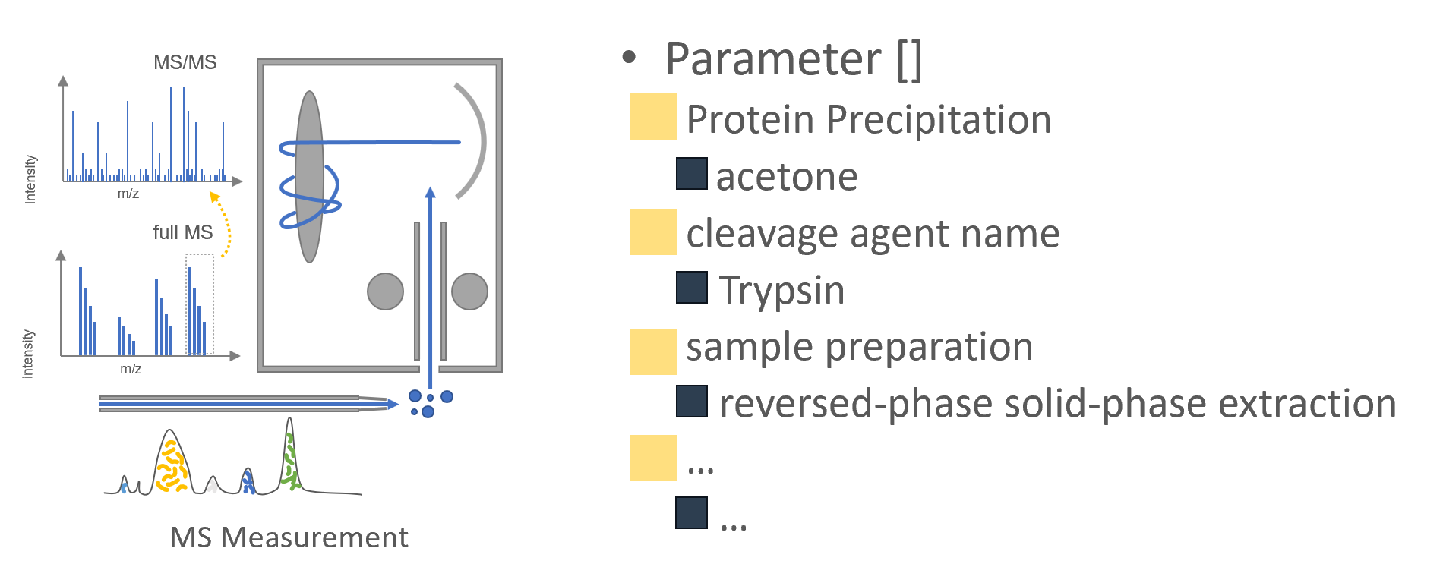
Applying standard procedures to sample record
=
S
apply (with standard values)
… … … … … … … … …

Slide 21
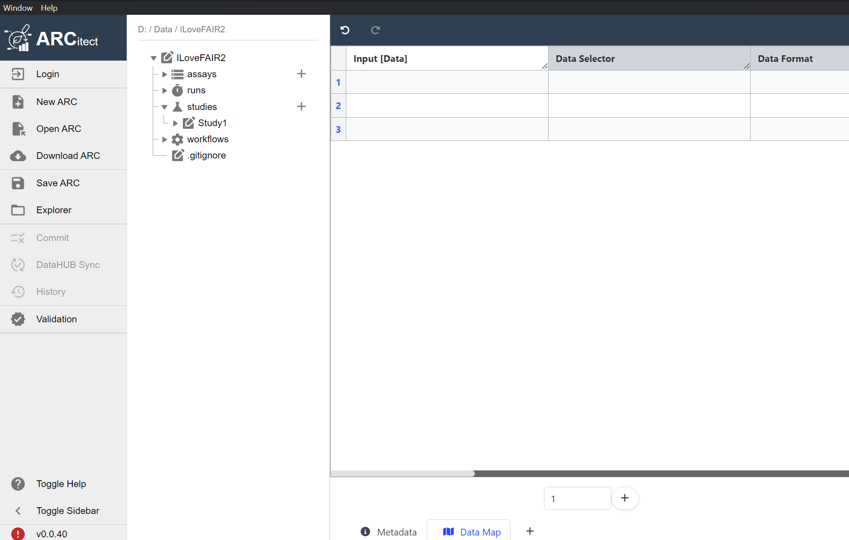
ARCitect demo time

Slide 22
Option I: Create a virtual assay

Slide 23
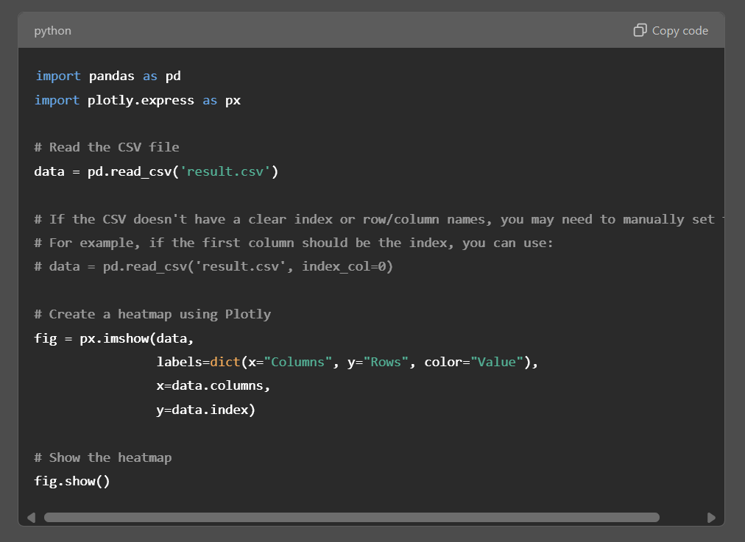
A computational workflow is like a protocol
computational workflow
computational workflow
[ ]
[ ]
result.csv
heatmap.py
result.csv
[ ]
computational workflow

Slide 24


A computational workflow is like a protocol
<study1>
resources
…
protocols
studies
<assay1>
dataset
assays
…
protocols
workflows
<workflow1>
script / code / …
…
CWL
runs
<run1>
data files
…
CWL
investigation
heatmap.py

Slide 25
Option II: Create a run and a workflow

Slide 26
A computational workflow is workflow
computational workflow
computational workflow
[ ]
[ ]
result.csv
heatmap.py
result.csv
[ ]
computational workflow

Slide 27
A workflow maps input data into a run result
<study1>
resources
…
protocols
studies
<assay1>
dataset
assays
…
protocols
heatmap.py
workflows
<workflow1>
script / code / …
…
CWL
runs
<run1>
data files
…
CWL
investigation

Slide 28
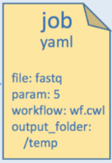
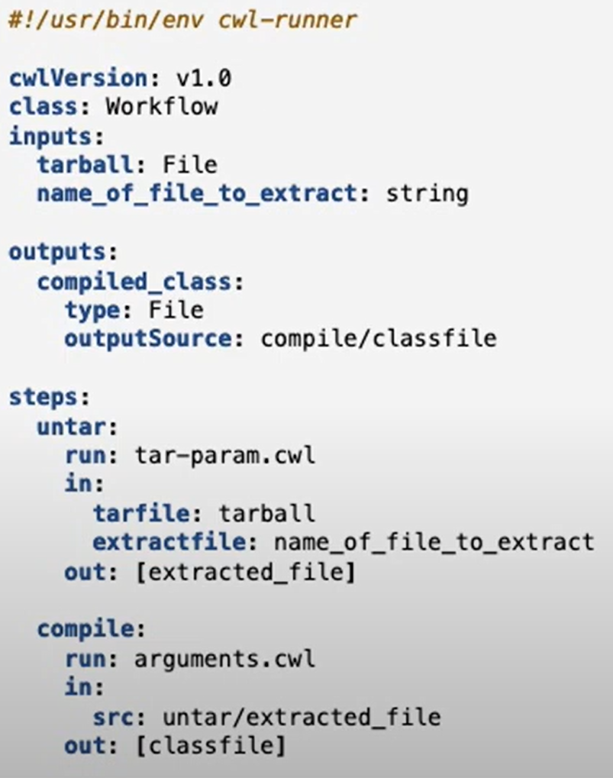
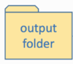
Using CWL abstract to wrap your workflow
CWL workflow document (*.cwl)
CWL job parameter (*.yaml)
1
2
3
CWL tool descriptors (*.cwl)
CWL runner

Slide 29


Build on existing well-established standards
administrative
experimental
<metadata>
CWL
computational
descriptive
structural
Integration of established (meta)data standards ensures compatibility by design

Slide 30
ARC: Annotated research context
experimental data
intensity
CAGAGGTGA
m/z
CAGAG
AGAGG
GAGGT
computation
controlled vocabulary
AGGTG
GGTGA
annotation
A
B
C
D
Your entire investigation in a single unified bag
https://github.com/nfdi4plants/ARC-specfication

Slide 31
ISA abstract model in a nutshell
Assay descriptive (meta)data information on the measurement
Characteristics
Parameters
Components
Factors
isa
Study descriptive (meta)data information on the subject
Characteristics
Parameters
Components
Factors
Investigation administrative (meta)data
Summary
Titel
Description
Person
Organisation
Publication reference
widely established within
the ‘omics community

Slide 32

Connected by similarity
administrative
investigation
isa
experimental
study
study
assay(s)
computational
CWL
+ parameter
run
result(s)

Slide 33




Support to bag your research
tooling
personal
Tools to facilitate creation and management of ARCs
On-site personnel assistance

Slide 34


DataPLANT service
Helpdesk
https://helpdesk.nfdi4plants.org/
E-Mail
info@nfdi4plants.org
Website
https://www.nfdi4plants.org/

Slide 35
Thank you for your attention

